Slide 1
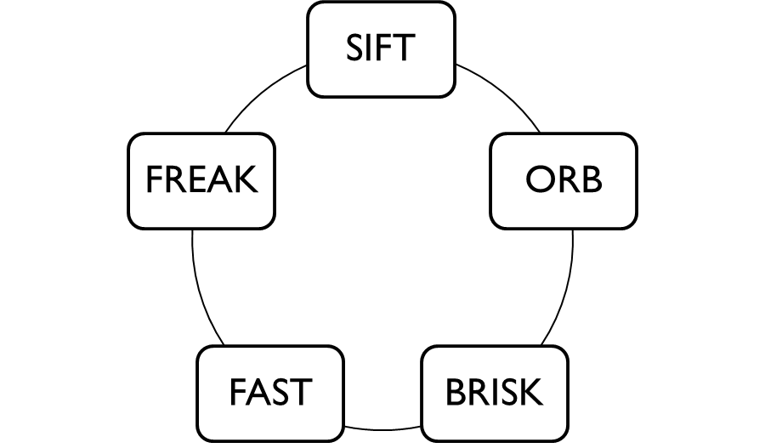
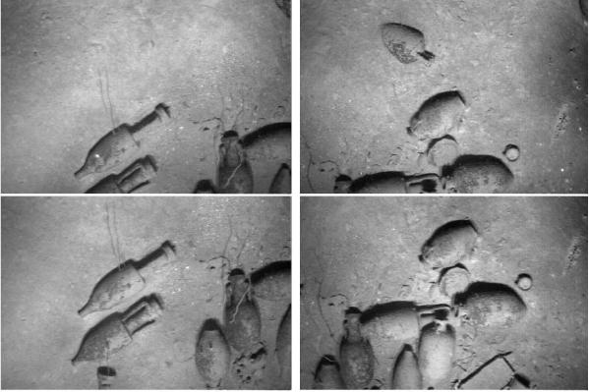
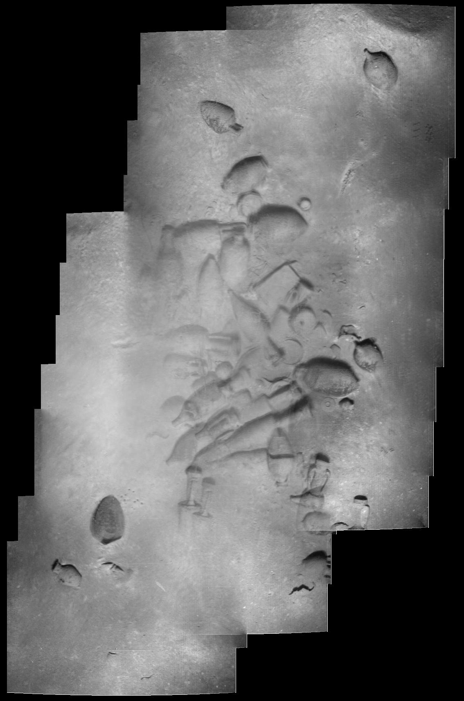
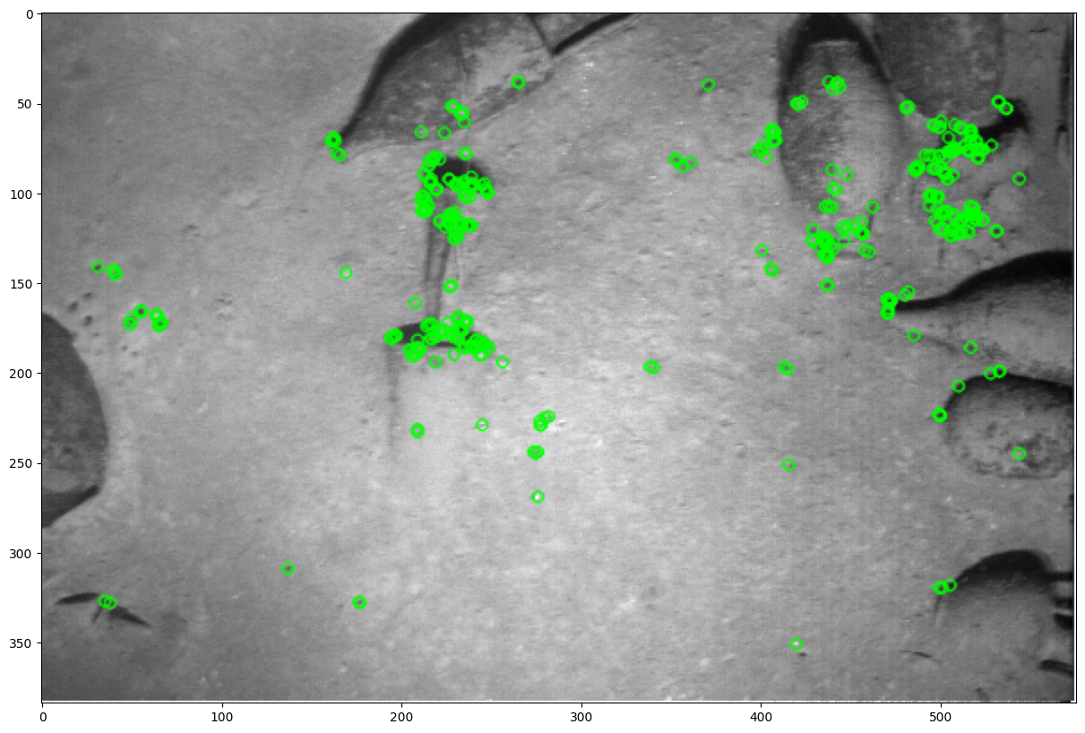
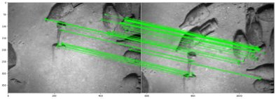
UNDERWATER FEATURE DETECTION & MAPPING
DATASET
OUTPUT
KEYPOINTS
FEATURE MATCHING
APPLICATIONS
Object Detection
Object Classification
Object Tracking
Image Segmentation
Image Mapping

